Slide 1

Bar-Ilan University
Faculty of Law
The International
Program
Israeli Law Degree
LLB

Slide 2
Welcome to Bar-Ilan Faculty of Law
Bar Ilan University Faculty of Law is at the forefront of legal research.
The Faculty is constantly developing and innovating new fields of research, study programs, legal clinics and more.
We offer excellent teaching and training and the most cutting-edge legal tracks of study.
The International
Program

Slide 3
Do you aspire to study law?
To think like a lawyer: analytical skills, critical thinking, express yourself eloquently in writing and orally, negotiation and representation skills.
To acquire broad education on law and society: Theoretical courses, research studies, hands-on and practical experience through workshops and legal clinics,
To enter an established profession: inhouse placement services for the internship period required by Israeli Bar, eligibility for other countries.
The International
Program

Slide 4
Do you aspire to study law?
At our faculty?
Bar Ilan University Faculty of law has excellent professors and teachers, many of them graduates of Ivy league and worldwide top Universities.
First and second year: studying the basic fields of the law – contracts, criminal law, public law, torts etc.
Third and fourth year: taking part in clinics, workshops, placements and seminars and focusing on one of our tracks.
The International
Program

Slide 5
Our tracks
Criminal law
Private law
Public law
The International
Program
Legal impact
Law & technology
Business law

Slide 6
Legal Clinics
The Faculty of Law at Bar-Ilan University is dedicated to championing the rights of all of Israel's citizens, and to inspiring its students and graduates to use their professional training to benefit others. In keeping with this mission, we have established eight Legal Clinics, which provide legal assistance, undertake legal research, and engage in educational activities and legal activism to advance causes that are not granted sufficient consideration in today's legal system.
The International
Program

Slide 7
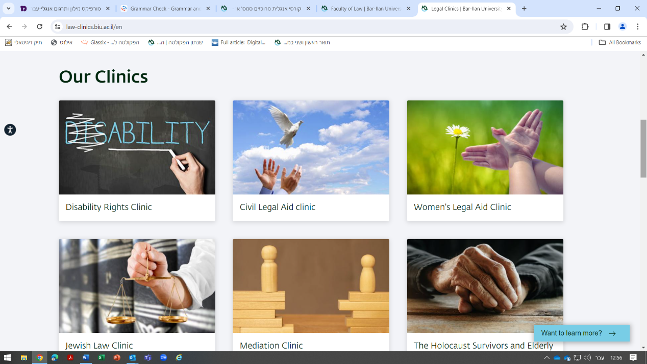
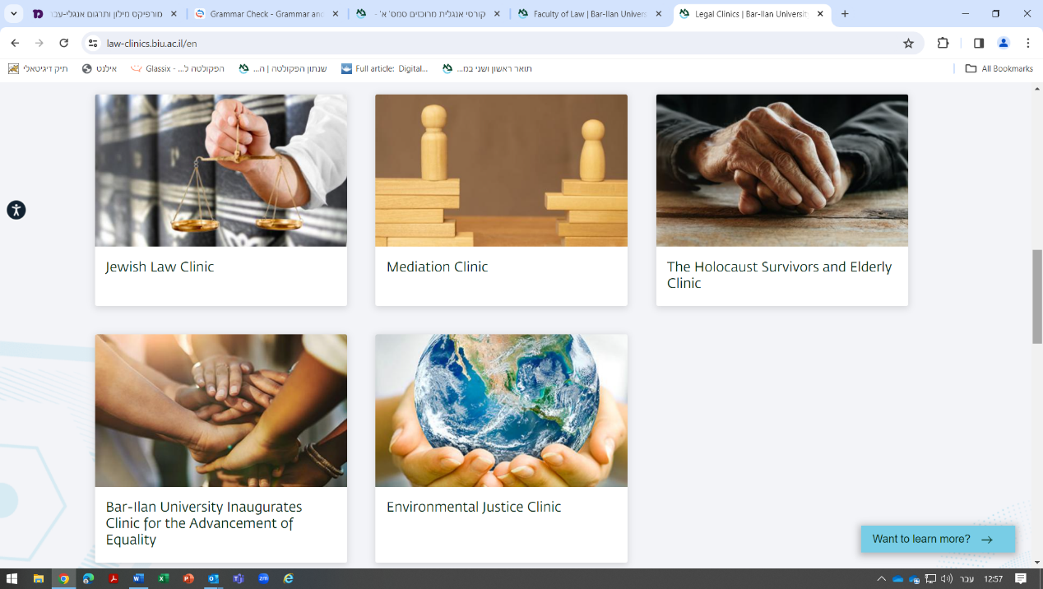

Our clinics
The International
Program

Slide 8
About the program
The first year is conducted in English accompanied by 800 hours of ulpan studies in Hebrew (200 will be dedicated to legally Hebrew studies). 3 Basic courses: criminal law, contract law, constitutional law.
The second year is an integrative year. The students will take part into the faculty’s program in Hebrew while assisted by a qualified staff through a designated program.
The third year the students will study the courses in Hebrew together with the Israeli students.
The International
Program

Slide 9
Admission Requirements
Who is the program for?
SAT Total Grade – 1,320 +
Admission to the track is subject to the discretion and approval of the university admissions committee
Candidates must submit:
A matriculation certificate/high school diploma including a transcript of record (certificates attesting post-matriculation study, if any( Recommendation letters or any relevant document (volunteering, etc).
The International
Program

Slide 10
Do you aspire to become an Israeli attorney?
Israeli Bar exam - The rate of BIU graduates’ Israeli Bar exam pass percentage is around 98%.
Law firms' integration -Our students are welcomed and integrated in top law firms in Israel and serve in many public offices as legal attorneys and policy makers.
Placement - We have a placement program for students to help students achieve the best internship in the market. We assist our students in writing resumes, we prepare them for job interviews, and we contact potential employers too.
Job fairs - We set up job fairs for students, where we host the best law firms and other working places to get to know our students.
The International
Program

Slide 11
Do you aspire to be a legal attorney abroad?
In most of common law legal systems, including USA and Canada, Israel’s LLB graduates are eligible to take Bar exams, depending on various conditions and additional requirements specific to each state.
The International
Program

Slide 12
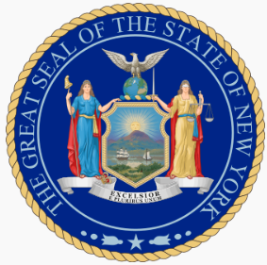



Bar Exams
LLB student from Bar-Ilan can registered to the:
New York Bar Exams
California Bar Exams
England and Wales Bar Examinations )SQE(*
* Solicitors Qualifying Examination
The International
Program

Slide 13
Thank you

