Slide 1
Student Exchange
Program
1

Slide 2
Student Exchange Program
Academic Studies abroad, during one or two semesters, while continuing to pay regular tuition at Bar-Ilan and receiving credits for the courses taken abroad.
Open to students from all departments and all degrees.

Slide 3
Student Exchange for Studies
Bachelor and Master students taking courses. The program enables students to take courses at leading academic institutions in Europe and receive academic recognition for them at BIU. Duration: one or two semesters

Slide 4
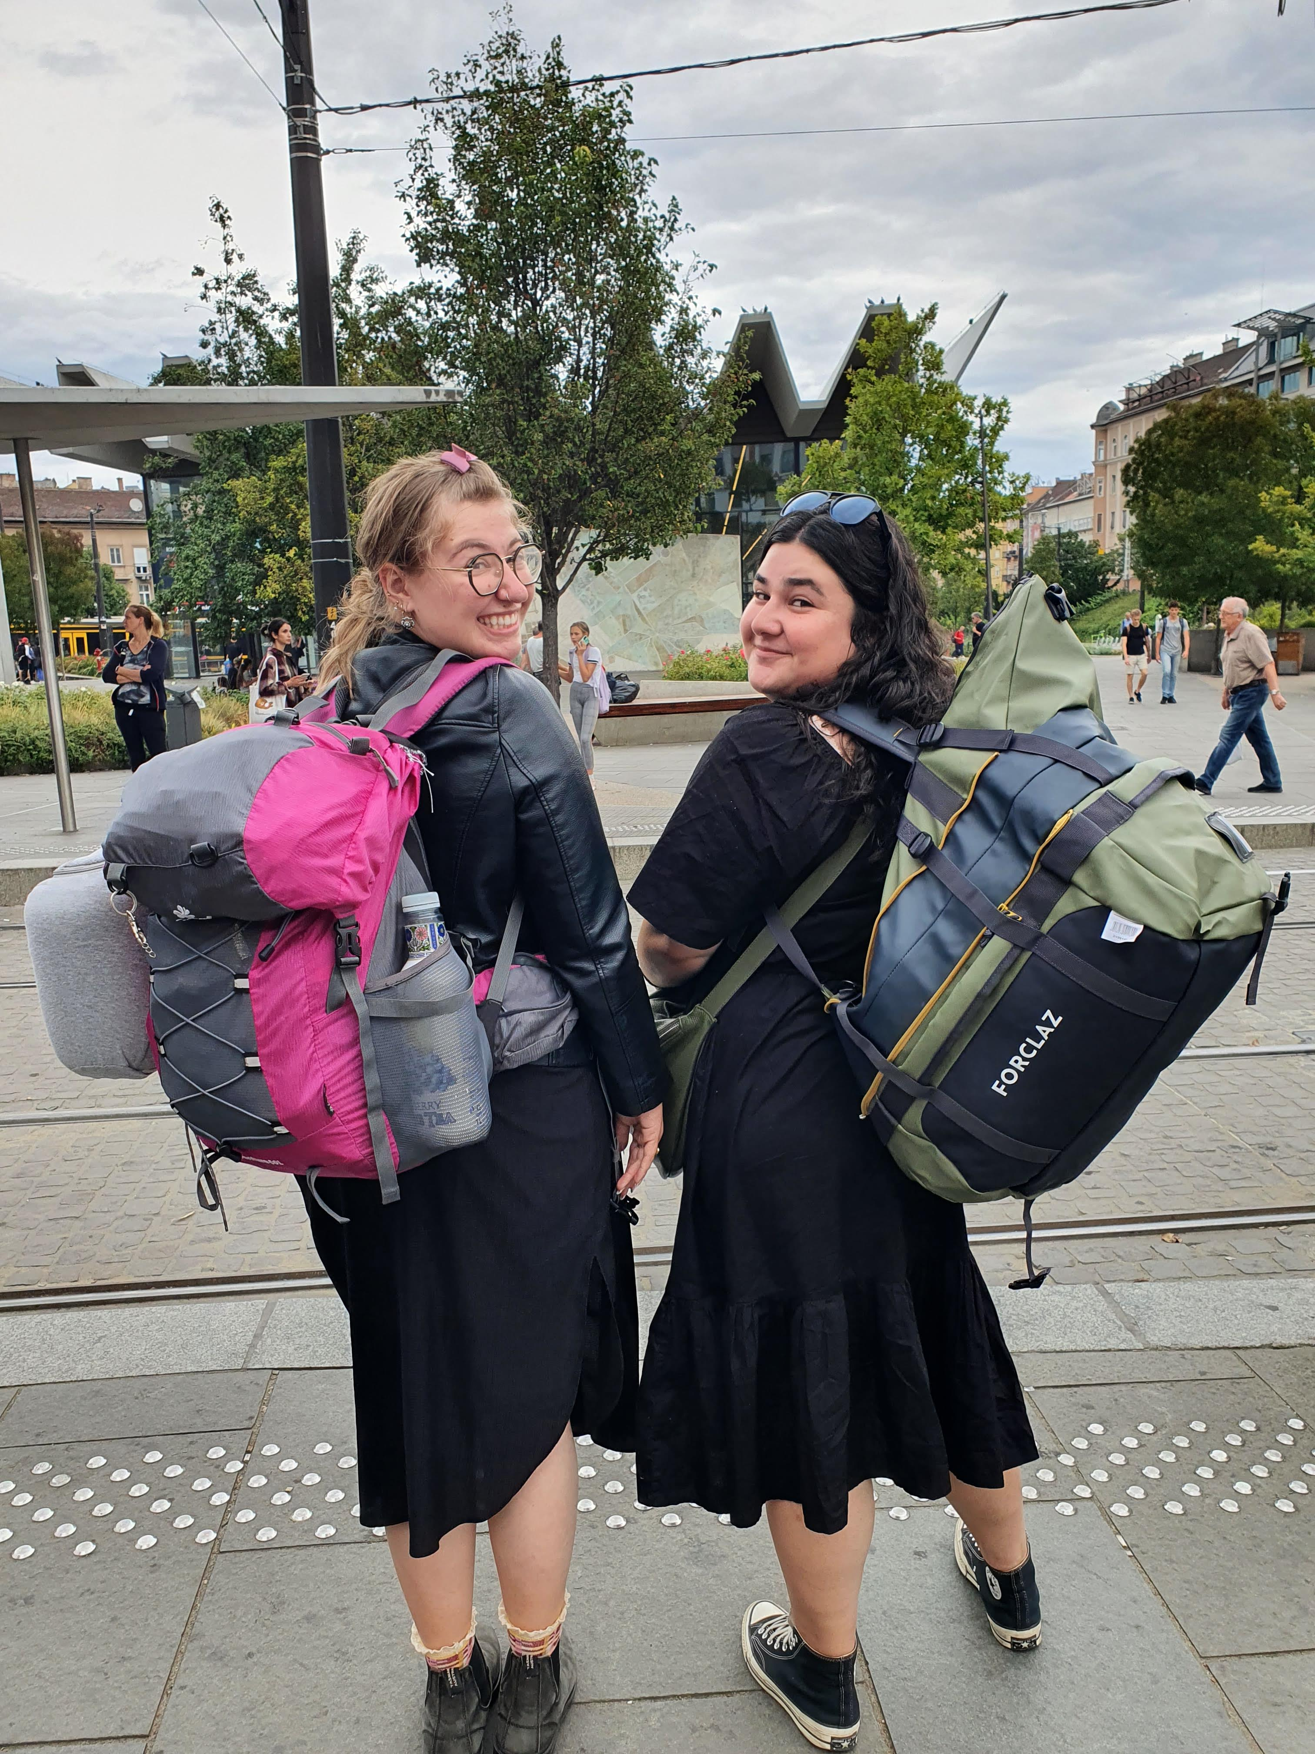
Student Exchange for Research
Master's degree students in the thesis writing phase and PhD students after the PhD research proposal has been approved.
This enables students to advance the research at a leading academic institution in Europe, subject to finding an academic mentor at the host university.
Duration: 1 week-12 months

Slide 5
Our Partners Around the World
Austria
Croatia
Czech Republic
Finland
France
Germany
Greece
Hungary

Slide 6
Our Partners Around the World
Ireland
Italy
Lithuania
Netherlands
Poland
Portugal
Romania
Spain

Slide 7
Erasmus+ Program
Erasmus+ is a program that supports student and faculty exchanges between universities in Europe and institutions outside the EU, including Israel.
The program offers scholarships from the European Union, which include:
A one-time payment for a round-trip flight to the destination country.
A monthly stipend that covers part of the living expenses.

Slide 8
Application Process
Registration for Semester A
December-January
Registration for Semester B
May-June

Slide 9
Thanks for joining us!

