Slide 2
Notes:
Was esstablised in 2001 after the intifada
StandWithUs is an international, non-profit and non-partisan Israel education organization that works to inspire and educate people of all ages about Israel, as well as challenge misinformation and fight against antisemitism.

Slide 3
Education

Slide 4
Digital

Slide 5
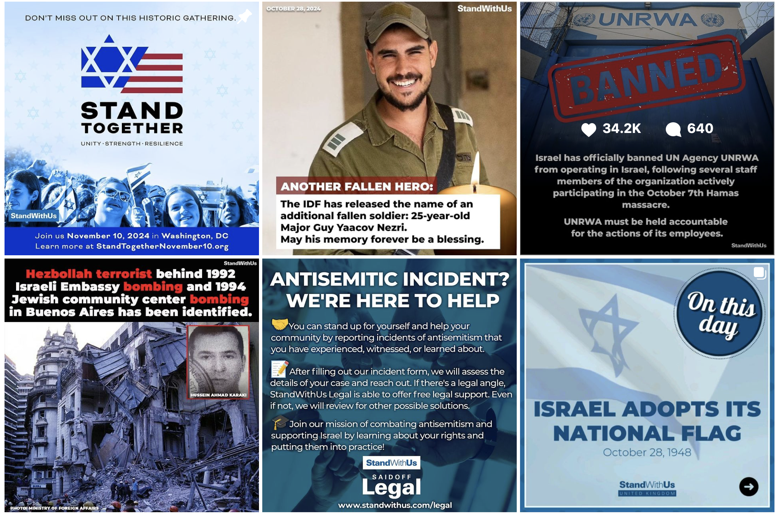

Slide 6
Training

Slide 7
The Ambassadors’ Club stands as the premier program in Israel Advocacy for International students at the Bar Ilan University.
From formal ambassadors to security experts, politicians and professionals in public-speaking, graduates of the Ambassadors’ Club are exposed to the best Israel has to offer in public diplomacy.

Slide 8
SCHEDULE
Session 1- Israel- Hamas war Wed., Nov 27
Session 2- Israel 101: history Wed., Dec 11
Session 3- Israel in the Digital Arena Wed., Dec 18
Session 4- Jewish Identities Wed., Jan 8
Session 5- Minorities in Israel Wed., Dec 22
Session 6- Humanitarian Aid Wed., Feb., 5
Session 7- Basic tools- ARM Wed., Feb., 19
Session 8- Closing session Wed., Mar., 3

Slide 9
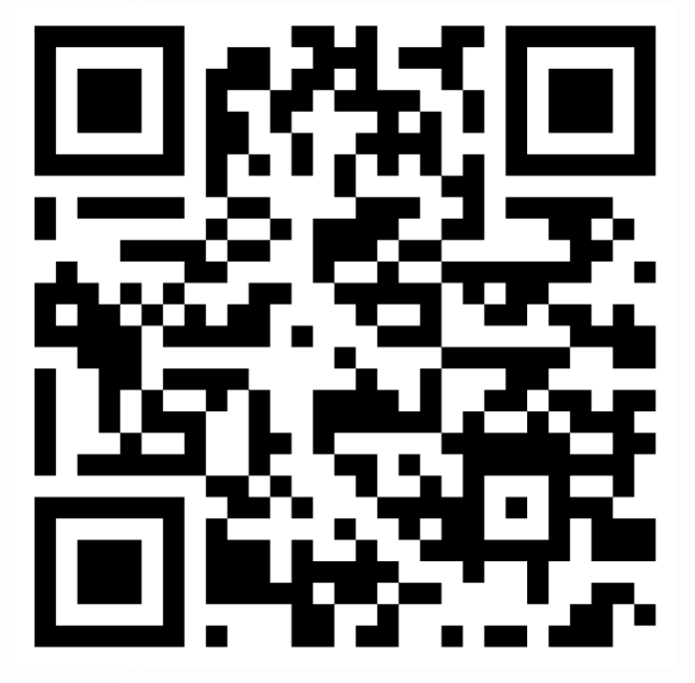
FOR REGERSTRITION
SCAN
HERE

