Slide 1

Office of the Dean of Students
●
Students Administration
Orientation Day | 2024

Slide 2
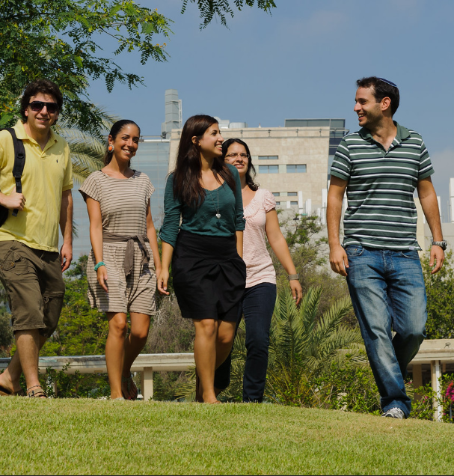


Our mission
Office of Dean of Students
The mission of the office of dean of students is to advocate for the well-being of the students on campus and strengthen the relationship between the student body and various (academic and administrative) bodies in the university.
Students Administration
Providing guidance and administrative support to applicants and students throughout the entire period of their university studies, starting from the application stage until the end of their studies.

Slide 3









Departments – Breakdown & Responsibilities
Student Support & Accessibility
Accommodations for coursework and exams for special needs and disability
Registration and admission to undergraduate studies (Israeli bagrut)
Applications & Admissions
Academics & Community
Enrichment courses, guidance for diverse populations, discourse program
Course exemptions, renewal of studies, extraordinary exam dates
Undergraduate admissions for foreign diplomas (Hebrew programs), support for Olim students
Dean of Students
Students Authority
Status Office
Olim & Wellbeing
Exam dates and management (physical and digital)
Student Advancement & Success
Student retention and guidance
Exam Office
Transcripts, degree eligibility, ranking
Student Mediation & Rights
Loans, rights for miluimnikim and parents, public and political activity
Registrar
Campus Dormitories
Dorm application process and room placement
Room placement, academic calender
Mechina program, Ulpan services
Course & Room Scheduling Unit
Mechinat Olim

Slide 4
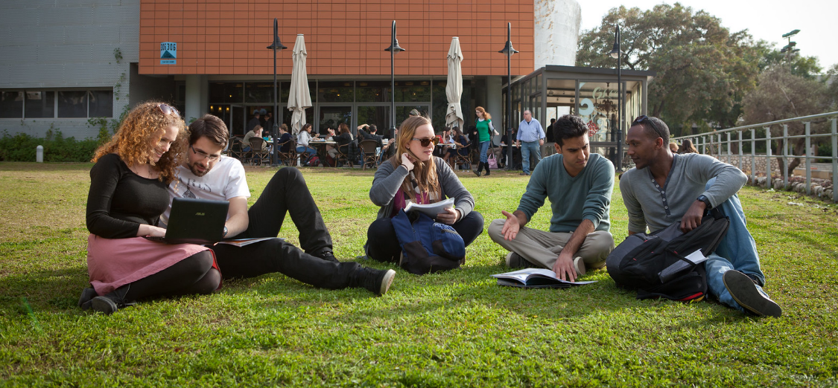
Department for Olim
Up to 7 years from Aliyah date (incl. army and national service)
Rights:
Use of a dictionary
  With approval of professor
No penalty for spelling mistakes
Extension of time on tests
  15 minutes per hour, up to 30 minutes
Translation of tests, 4 per semester (1st year only)
Tutoring sessions
Financial assistance:
Guidance with Minhal Studentim Olim scholarship
Interest-free loans
Social Activities:
Social events
Community involvement (Shachak)

Slide 5

Contact Information
Office of Student Support & Accessibility
Negishut.Student@biu.ac.il
03-5318491
Mechinat Olim
Mechina.Office@biu.ac.il
03-531-8653
Department of Academics & Community
Dikla.Sher@biu.ac.il
077-364-3584
Department for Olim & Wellbeing
Olim.Wellbeing@biu.ac.il
077-364-3585
The Office for Student Advancement & Success
Dean.Kidum@biu.ac.il
03-5317640
Registrar
Open Door service
Student Mediation & Rights
Students.Services@biu.ac.il
03-5318652
www.https://www.biuopendoors.co.il/
Google:
דלת פתוחה בר-אילן
Search for name of department/faculty
Exam Office
Open Door service
Campus Dormitories
Meonot.office@biu.ac.il
03-5318392
Status Office
Open Door service

